Slide 1
Transparency and Reproducibility in Economics: Lessons learned from 1,000 papers
Lars Vilhuber
Cornell University
The opinions expressed in this talk are solely the authors, and do not represent the views of the U.S. Census Bureau, the American Economic Association, or any of the funding agencies.
© Lars Vilhuber .
Notes:
I am going to
Very briefly describe the background we are coming from
Make note of the various elements of progress (and the broader picture) of open science
Describe some of the ongoing challenges
Provide some guidance based on the lessons learned in the past year

Slide 2
3 Lessons (and many solutions)
Lesson 1: Computational empathy
Lesson 2: Data acumen
Lesson 3: Role of institutions

Slide 3
A bit of background

Slide 4

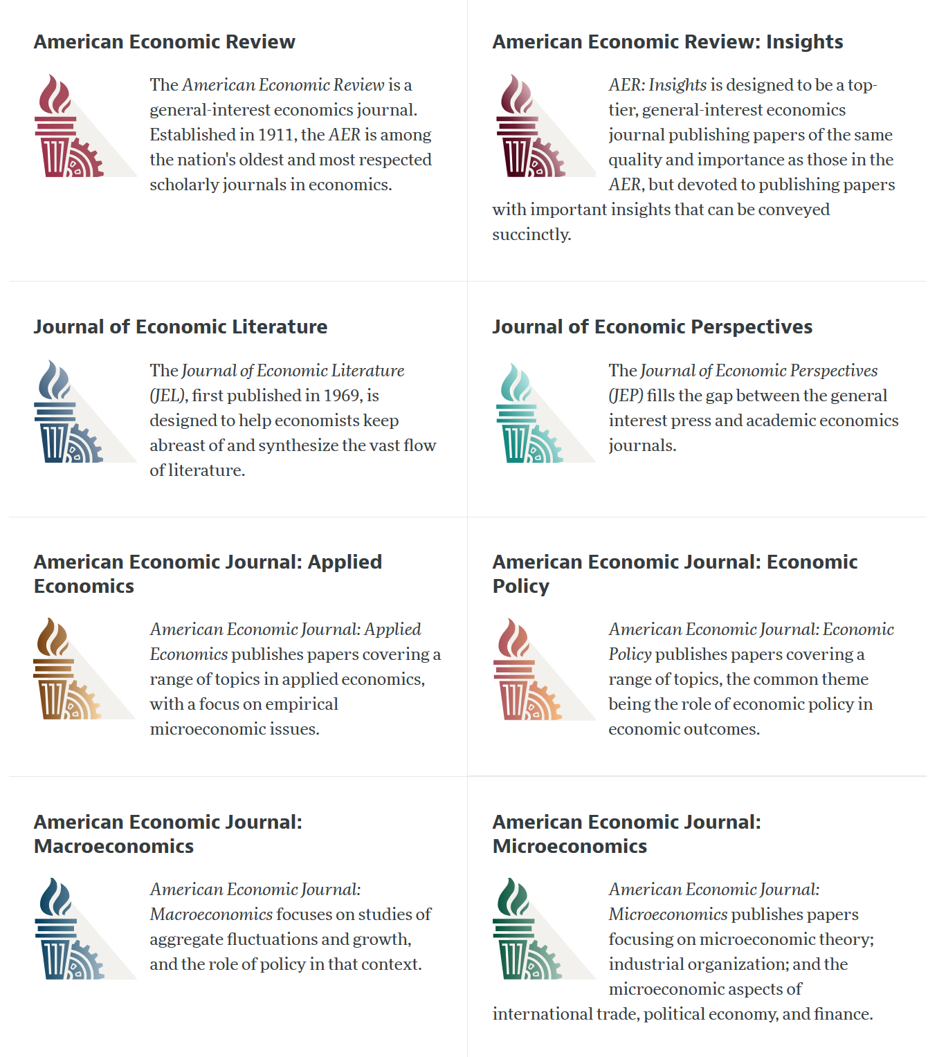

Slide 5
AEA Data & Code Availability Policy (2019)
It is the policy of the American Economic Association to publish papers only if the data used in the analysis are clearly and precisely documented and access to the data and code is clearly and precisely documented and is non-exclusive to the authors.
Authors of accepted papers that contain empirical work, simulations, or experimental work must provide, prior to acceptance, the data, programs, and other details of the computations sufficient to permit replication, as well as information about access to data and programs.

Slide 6
Current efforts at the AEA
Pre-emptively improve code archives
By conducting reproducibility checks when we can
By working with groups that conduct reproducibility checks when we cannot
Better archives
Greater transparency of the code and data archives
Better provenance tracking
Leave code where it is when appropriate
Leave data where it is almost always
Display that information
Notes:
Add logo from AEA

Slide 7
AEA Pre-Publication Verification
Every paper that receives a “conditional acceptance” is verified
Data citations
Quality of README
Quality of code
Reproducibility of code
Quality of metadata in the repository

Slide 8
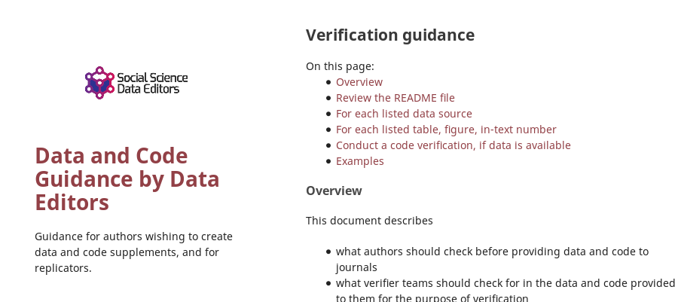

Action: Reproducibility Check

Slide 9
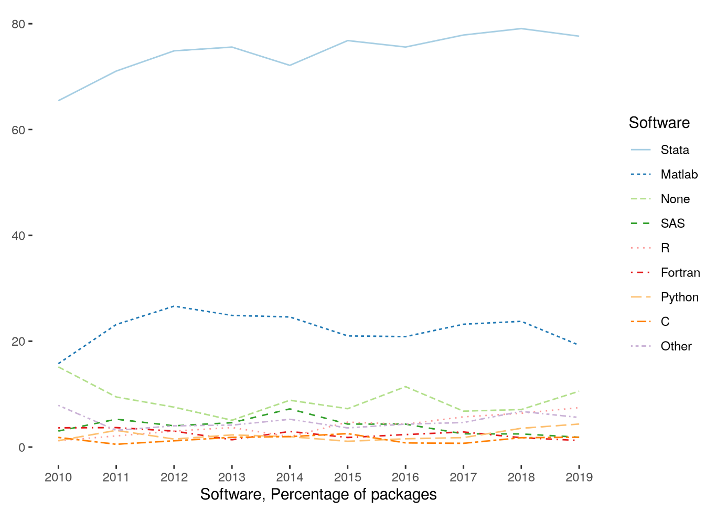
Very little diversity in software
Stata is the most popular statistical software in the journals of the AEA (72.96% of all supplements)
followed by Matlab (22.45%)

Slide 10
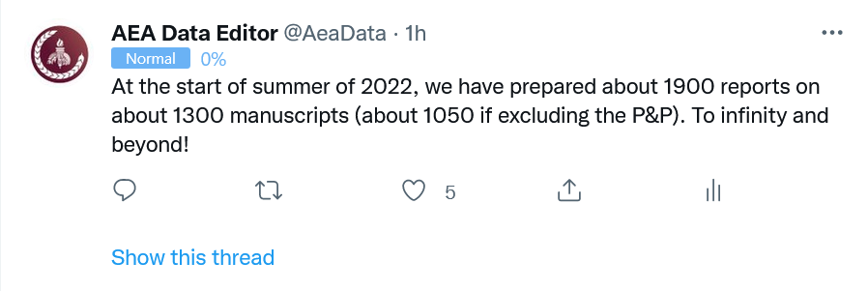
Stats on reproduced articles
Between July 16, 2019, and June 20, 2022, the AEA Data Editor team conducted
1900 assessments
for 1050 manuscripts (full papers)

Slide 11
Defining “reproducible research”
“Reproducibility” refers to the ability of a researcher to duplicate the results of a prior study using the same materials and procedures as were used by the original investigator.
Bollen et al. 2015. “Social, Behavioral, and Economic Sciences Perspectives on Robust and Reliable Science.” National Science Foundation.https://www.nsf.gov/sbe/AC_Materials/SBE_Robust_and_Reliable_Research_Report.pdf.

Slide 12


Ingredients of “research”
“Procedures” = computer code
“Materials (1)” = data
“Materials (2)” = computers

Slide 13
Lessons?

Slide 14
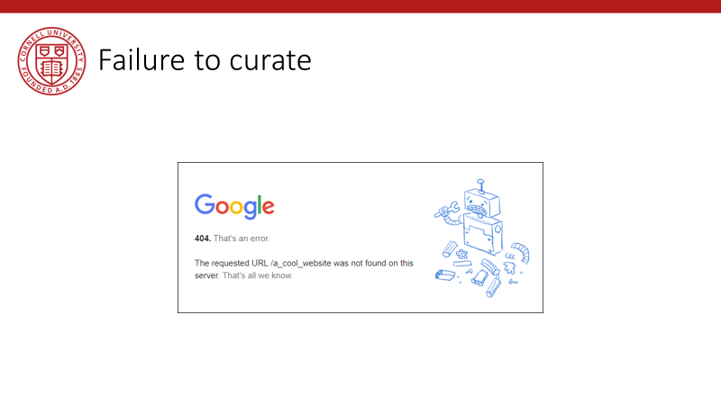
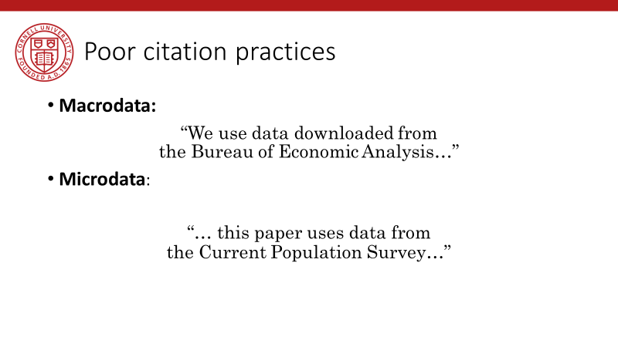
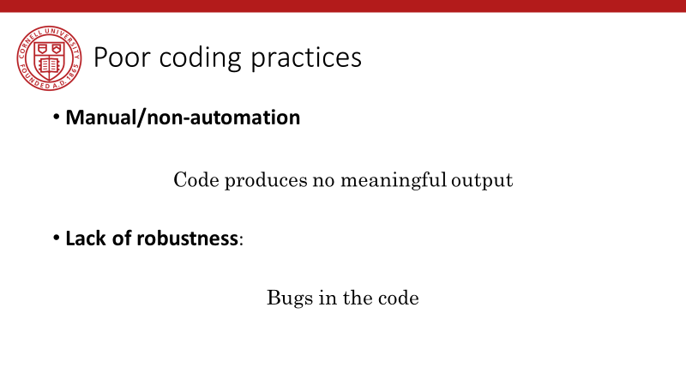
Back in 2019…

Slide 15
Observation 0
Researchers don’t…
Re-run their code before submitting
Don’t streamline (automate) enough
Are not careful about how they document data sources
Fail to curate their own data

Slide 16
Computational empathy

Slide 17
Lesson 1: Computational empathy
In the words of the slogan popularized by Buckheit and Donoho (1995),
“a scientific publication is [...] merely advertising of the scholarship: [...] the complete software development environment and the complete set of instructions which generated the figures.”

Slide 18
Lesson 1: Computational empathy
Put yourself in the position of the reader of the research compendium:
Can they understand those instructions?
Under what premises/ shared common knowledge?
What might they assume about the computing environment?
How concise or diffuse are the instructions?

Slide 19
Lesson 1: Computational empathy
Potential readers
You (in 4 years, between prepping 2 new courses, an R&R, a new child, and tenure coming up in 2 years)
Your RA (in 4 years, because you are… see above)
Your future readers who will cite you (in 4-10 years, who may want to extend or replicate your study, but won’t if it is too complex)

Slide 20
Lesson 1: Computational empathy
= “Pity the poor replicator”

Slide 21
Intermezzo

Slide 22
Observation 1
Social scientists do not read the manual
(beyond the first few pages)

Slide 23
Observation 1: Please read the manual
Persistent misconceptions
About setting working directories
How to record pathnames
How to leverage loops
How to leverage subroutines
How to pass parameters
How (and if) to use controller scripts

Slide 24
Observation 2
Social scientists love point-and-click interfaces (which are hard to reproduce)

Slide 25
Observation 2: point-and-click interfaces
This is reflected in
GIS (maps) that appear in papers
Data extraction tools
How to run software (any software)

Slide 26
Observation 1 and 2 are the result of a lack of Computational Empathy, and lead to high burden of reproducibility and replicability

Slide 27
Solutions?

Slide 28
Hold that thought, we will get there.

Slide 29
Data acumen

Slide 30
Data acumen
“the ability to understand data, to make good judgments about and good decisions with data, and to use data analysis tools responsibly and effectively”
National Academies of Sciences, Engineering, and Medicine. 2018. Data Science for Undergraduates: Opportunities and Options. Washington, DC: The National Academies Press. https://doi.org/10.17226/25104.

Slide 31
Lesson 2: Data acumen in the context of reproducibility
Two key components
Data provenance
Where did the data come from which I used?
Data preservation
Where do I put the data I generated?
What if the data I used are not “robustly preserved”?
What do you mean by that?

Slide 32
Data provenance

Slide 33
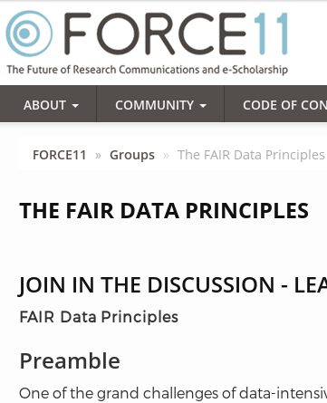
Action: Data citations and metadata
What is FAIR?
Findable,
Accessible,
Interoperable, and
Re-usable

Slide 34
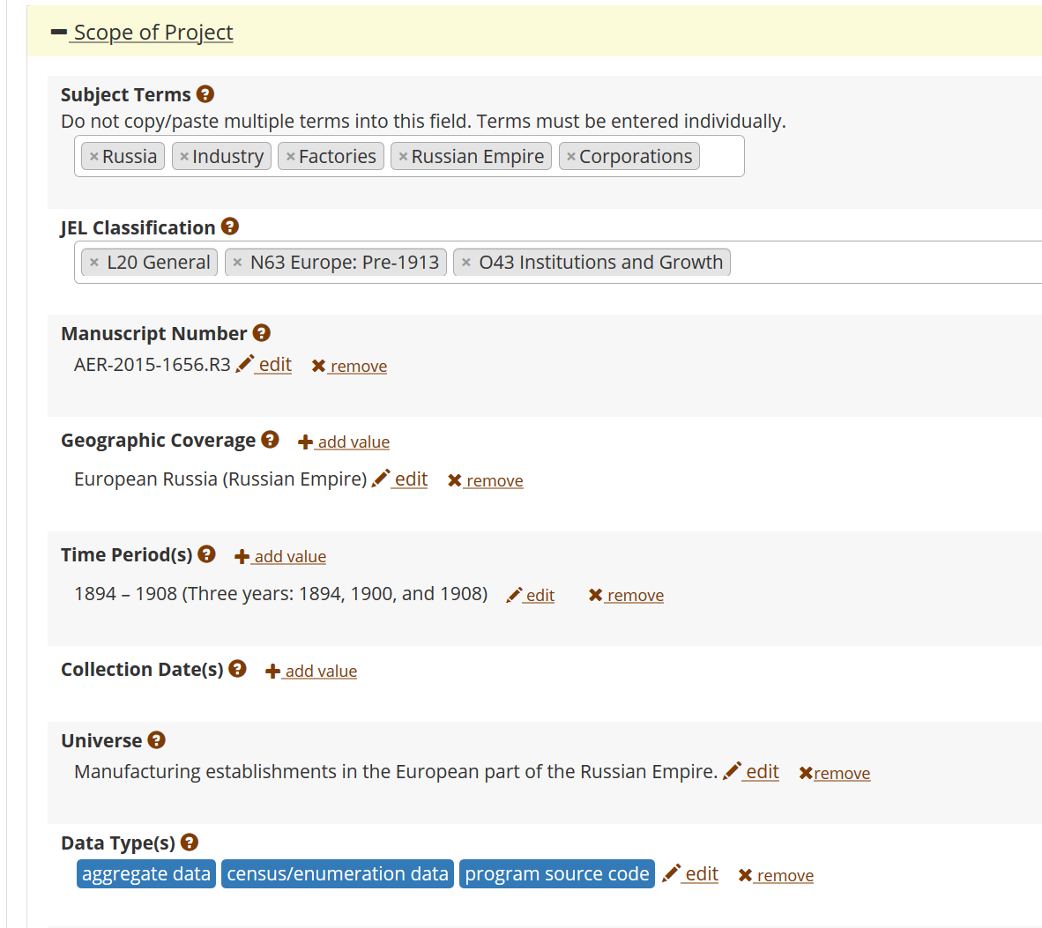
FAIR data principles rely on metadata
Notes:
Show metadata for this page

Slide 35
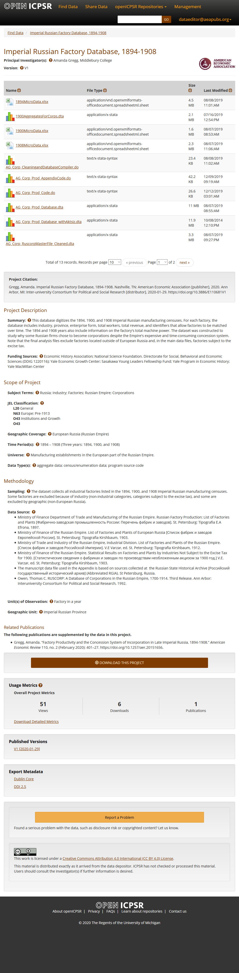

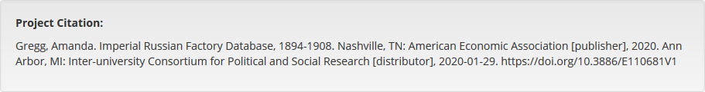
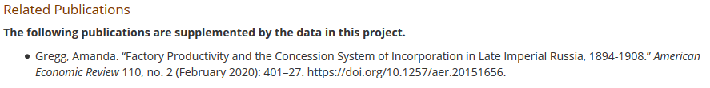

Slide 36
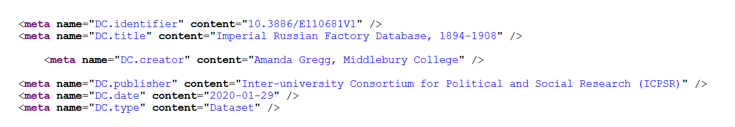

Slide 37
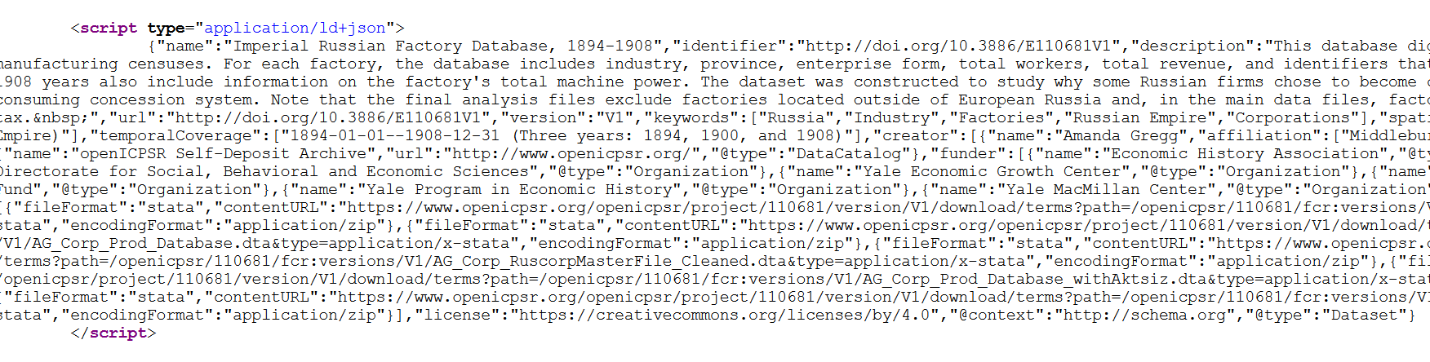

Slide 38
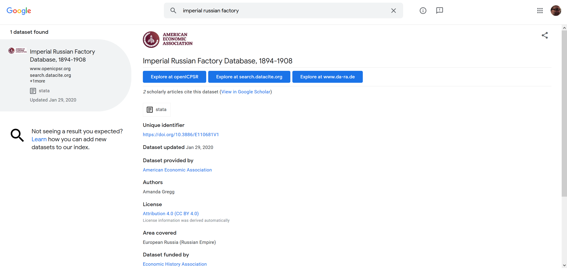
… and findability relies on metadata

Slide 39
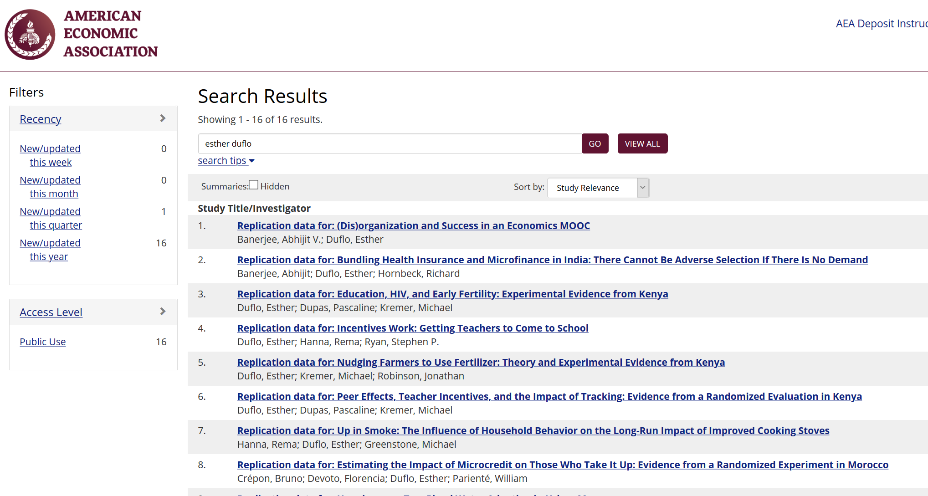

Slide 40
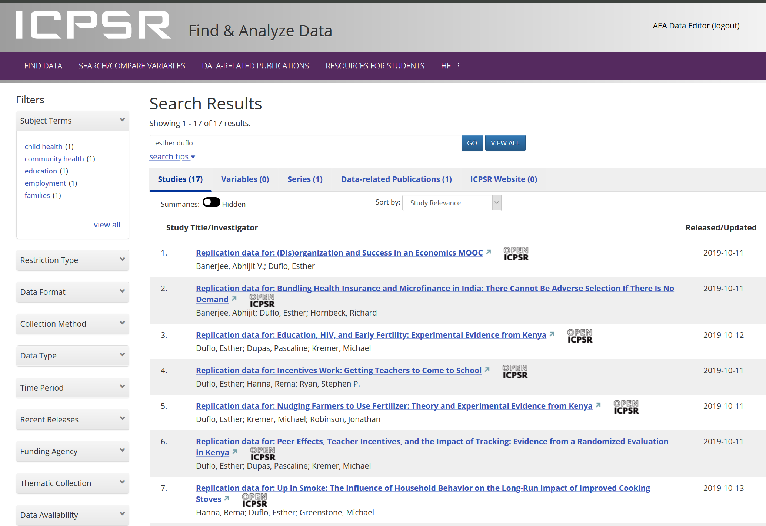

Slide 41
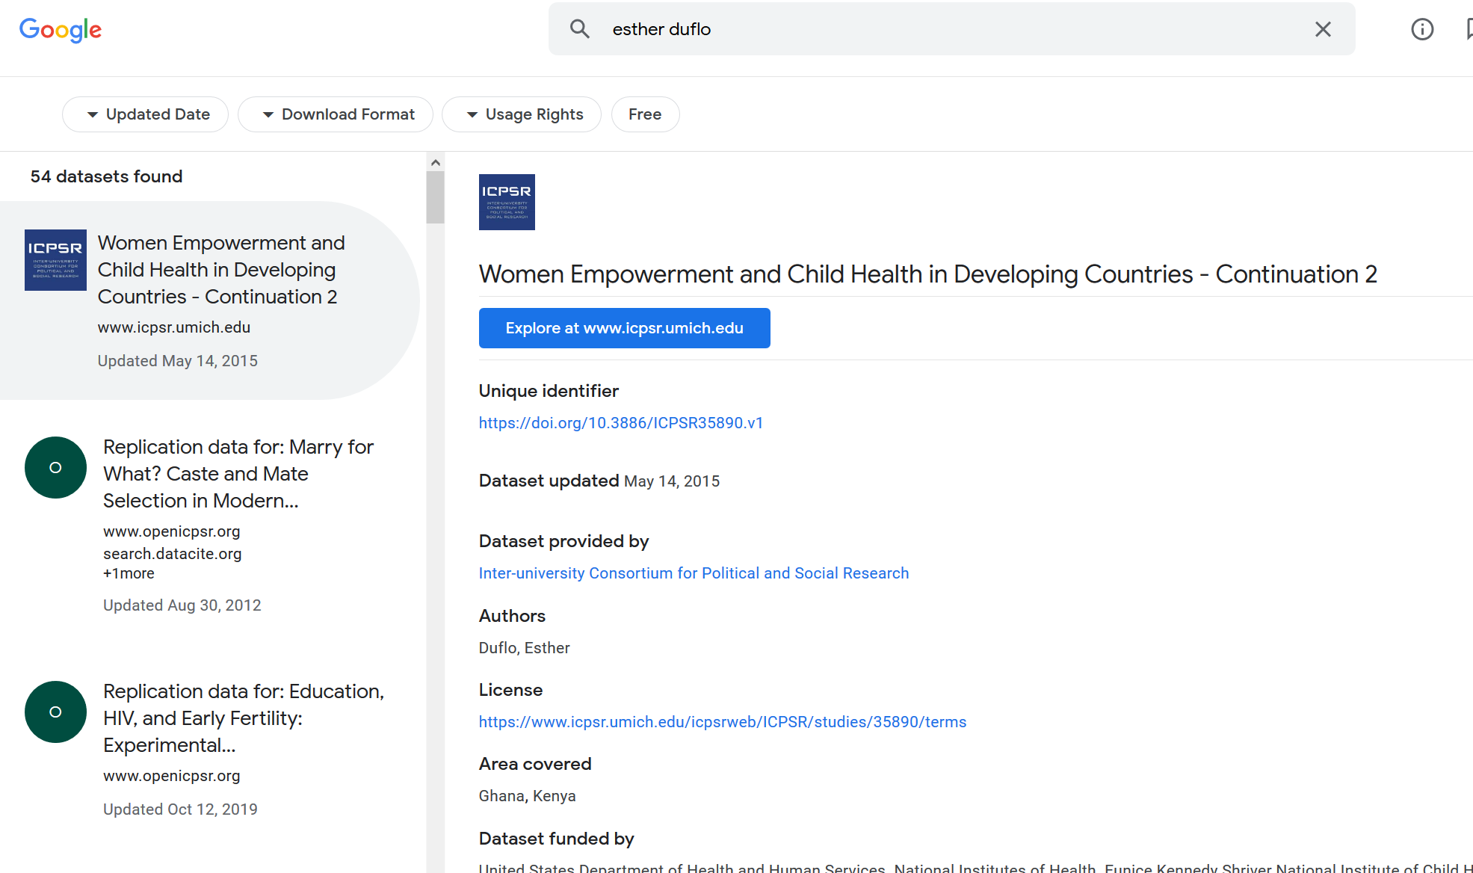

Slide 42
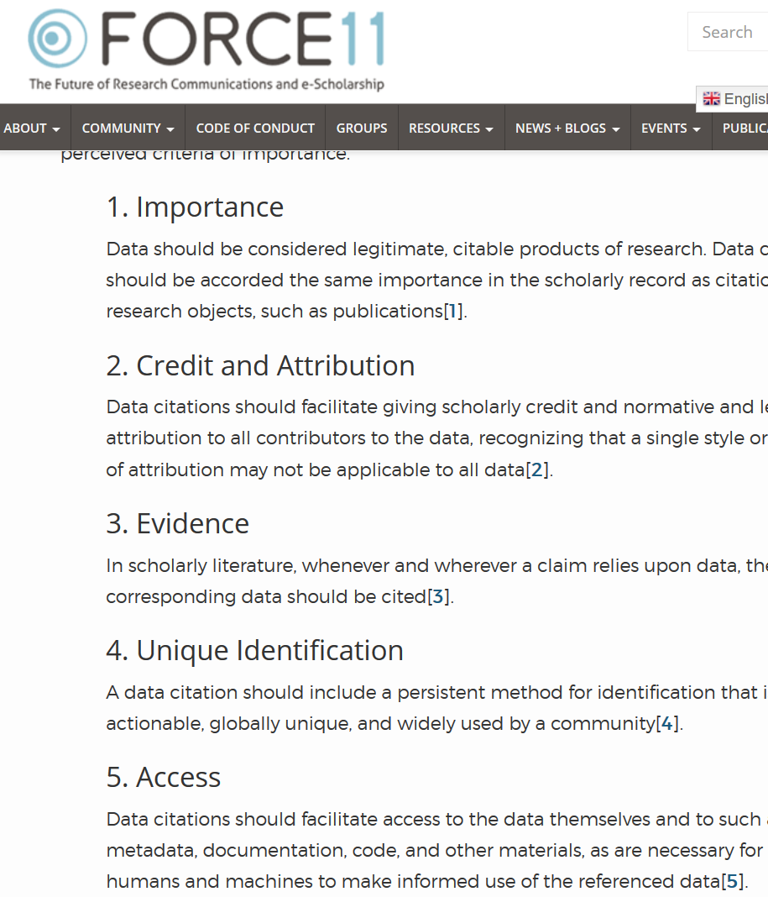

Starts with Data Citations
Data Citation Principles
Image of a standard data citation
Data Citation Synthesis Group: Joint Declaration of Data Citation Principles. Martone M. (ed.) San Diego CA: FORCE11; 2014 [https://www.force11.org/group/joint-declaration-data-citation-principles-final].

Slide 43
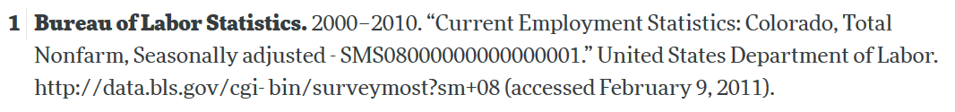
Starts with Data Citations
Data Citation Principles
Image of a standard data citation
Data Citation Synthesis Group: Joint Declaration of Data Citation Principles. Martone M. (ed.) San Diego CA: FORCE11; 2014 [https://www.force11.org/group/joint-declaration-data-citation-principles-final].

Slide 44
Observation 3
Social scientists are not trained to cite data

Slide 45
Citing restricted-access data
“Well, I can’t download the data, so I can’t cite it.”

Slide 46
Some practical tips
(based on 1000 articles)

Slide 47
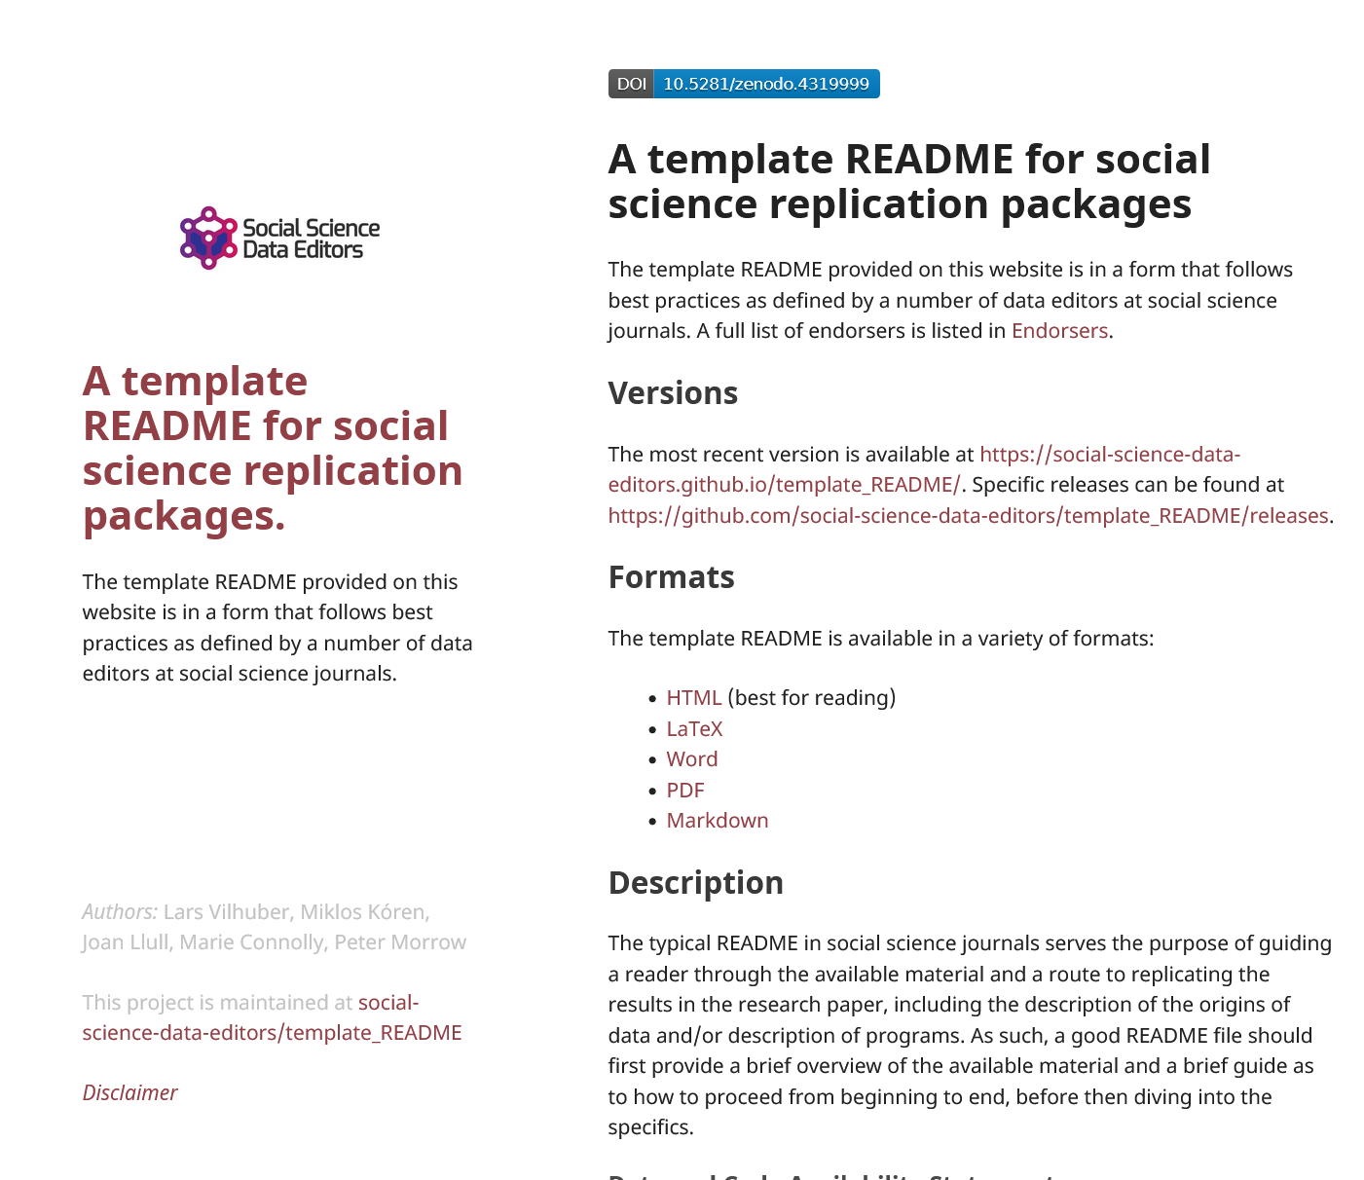
Computational empathy
Focal reader: your next RA in 4 years
Interaction: you hand them your README, but don’t have time to go through all the details…
Budget constraint: It shouldn’t take too many RA hours
Time constraint: It shouldn’t take more than 1 week to “get it”

Slide 48
Solution 1: Computational Empathy
Use the Social Science Data Editors’ template README https://doi.org/10.5281/zenodo.4319999

Slide 49
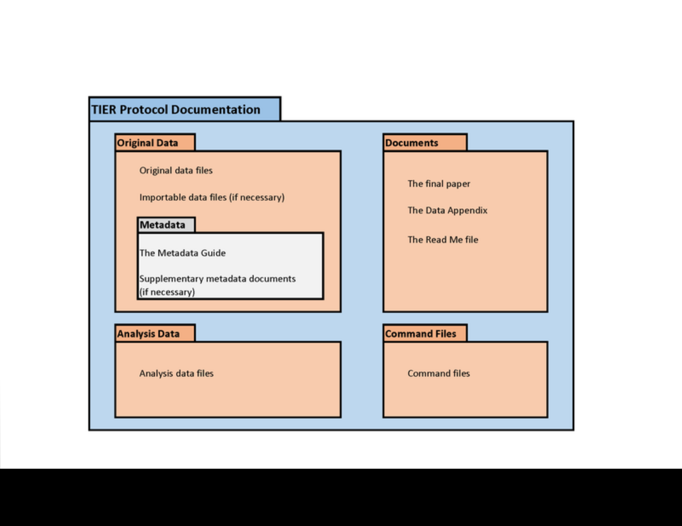
Data provenance
Keep all information as you collect data
See TIER Protocol for good and simple guidance
If you must use a point-and-click tool, keep detailed instructions
Also: obsolescence
Try to use API, bulk download, or packages that allow for extraction
Also: obsolescence of API

Slide 50
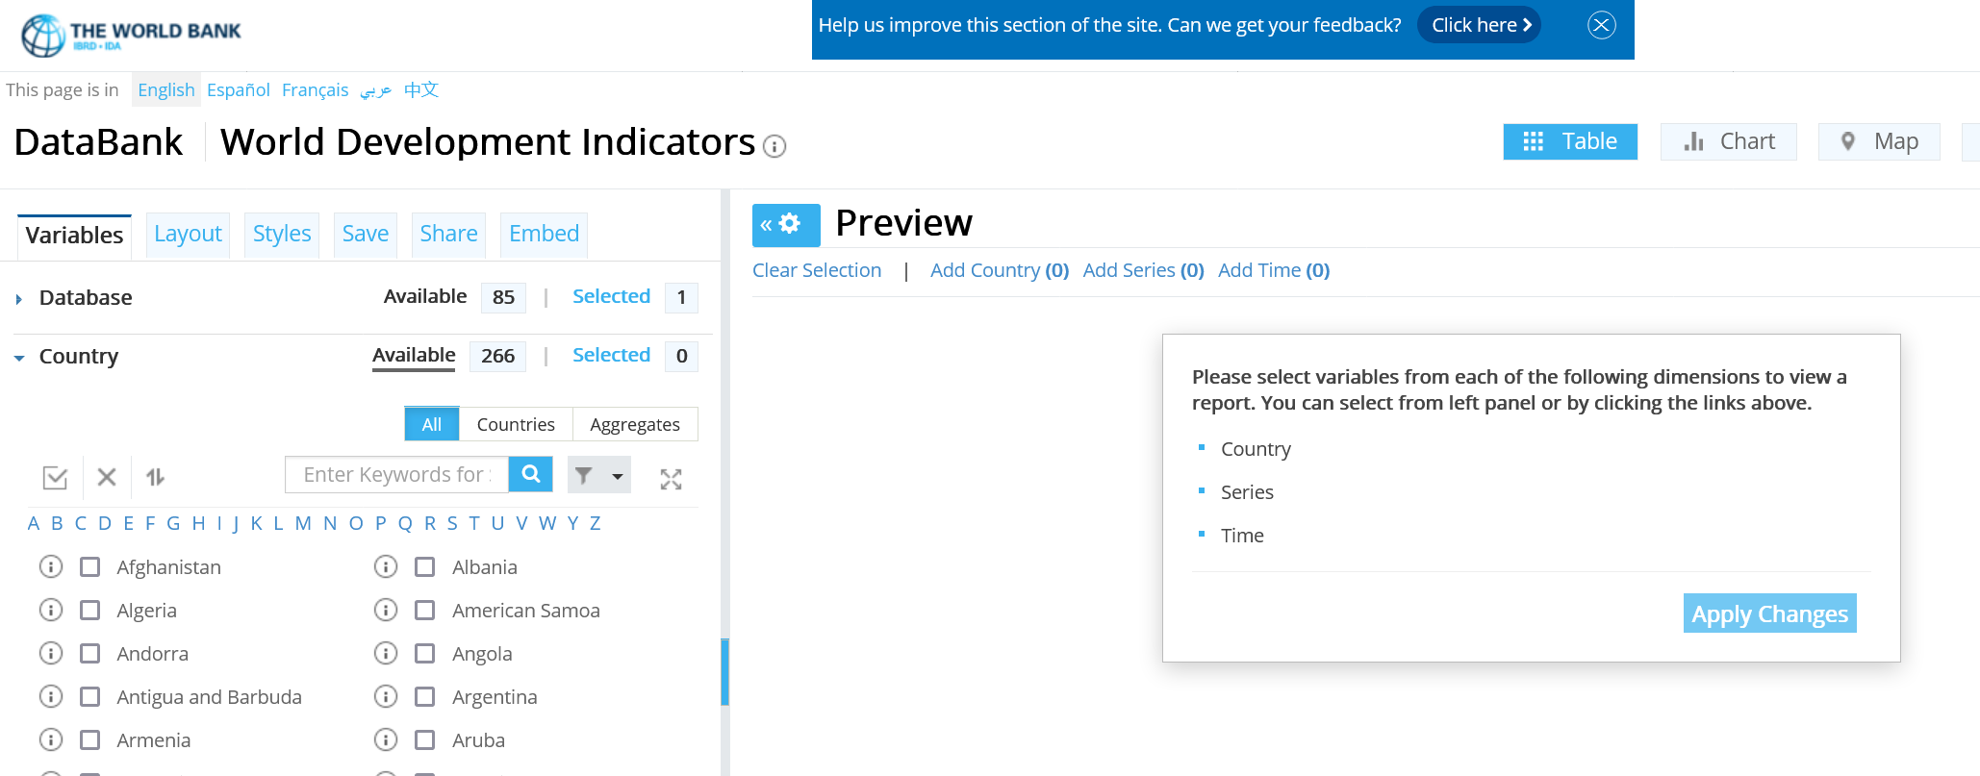
API? But the interface is so cool!
World Development Indicators

Slide 51
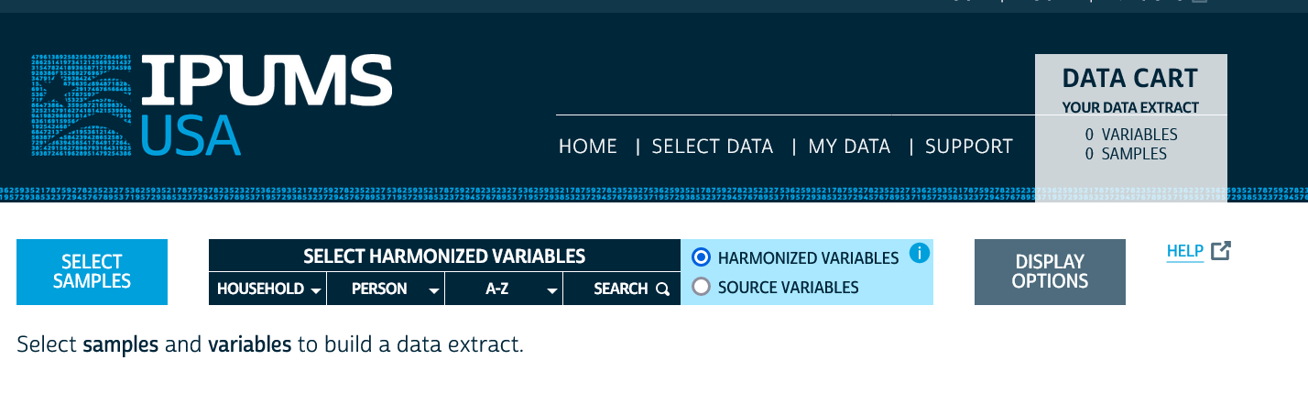
API? But the interface is so cool!
IPUMS

Slide 52
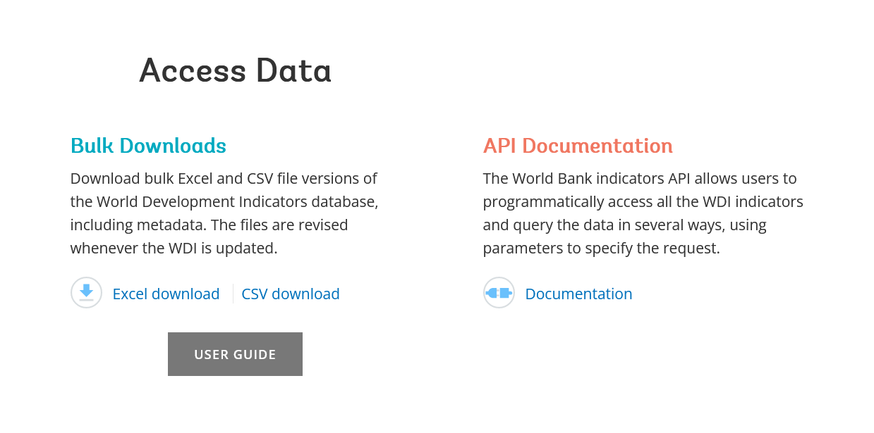
API or Bulk Download
World Development Indicators

Slide 53
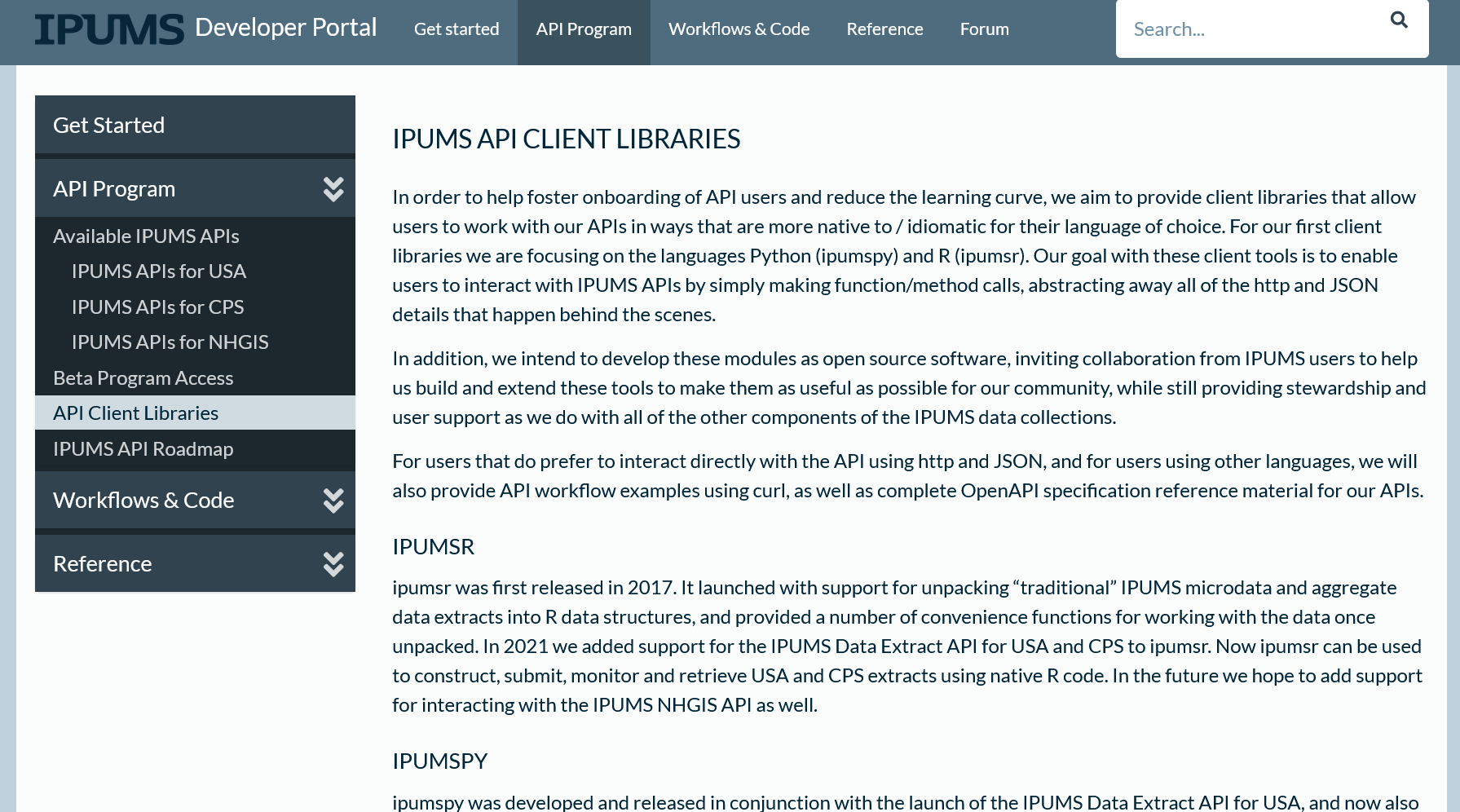
API or Bulk Download
IPUMS (beta)

Slide 54
Don’t forget to check the TERMS of USE!

Slide 55
Because you may not be able to provide others with a copy of the data (legally)…

Slide 56
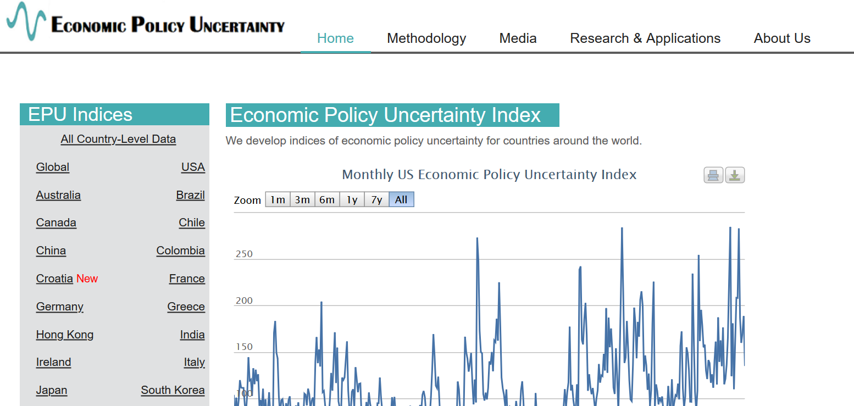
Example 2: Academic data publisher

Slide 57

Example 2: Academic data publisher

Slide 58

Example 2: Academic data publisher-new!

Slide 59
Rights to use data
You browsed a website
You purchased the data
You signed a data use agreement
You created the data (lab experiment)
You had survey respondents consent to use (IRB approval!)

Slide 60
Rights to distribute the data
If you created the data, you decide.
If you got it from somewhere else:
READ THE TERMS OF USE / DATA USE AGREEMENT / CLICK-THROUGH / ETC.

Slide 61
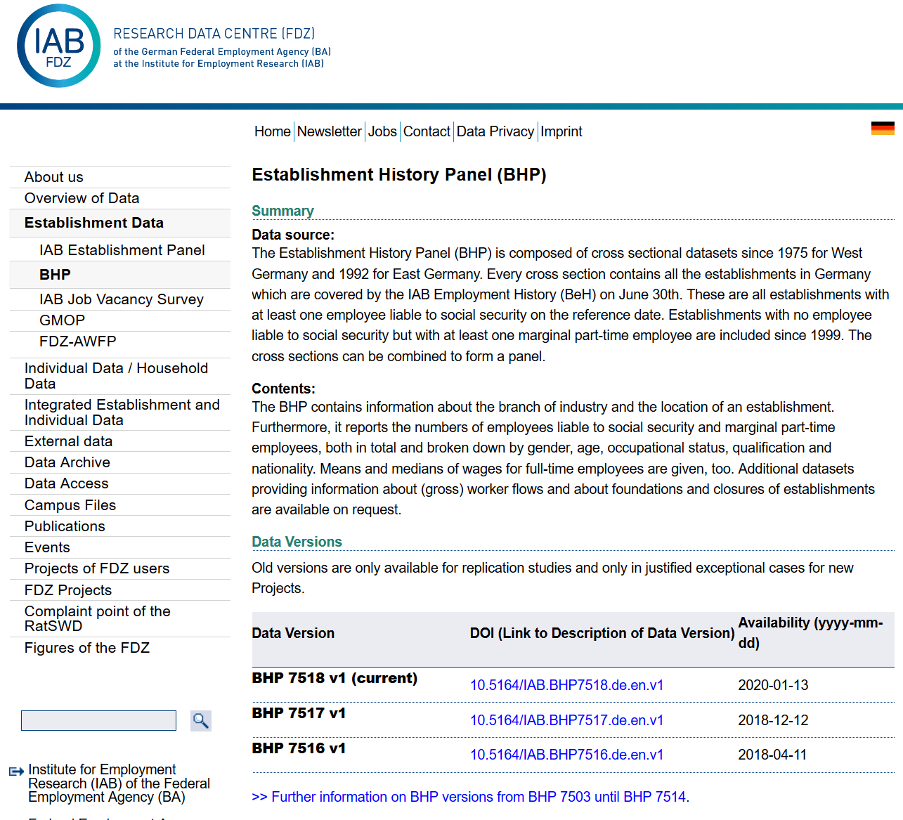
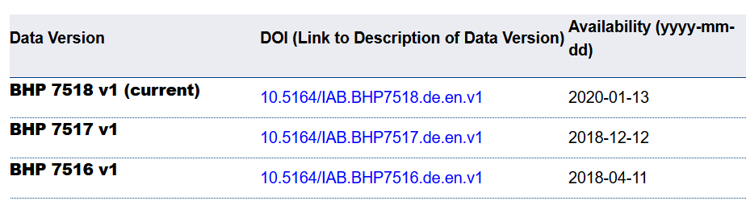
Example 4: German Restricted-access

Slide 62

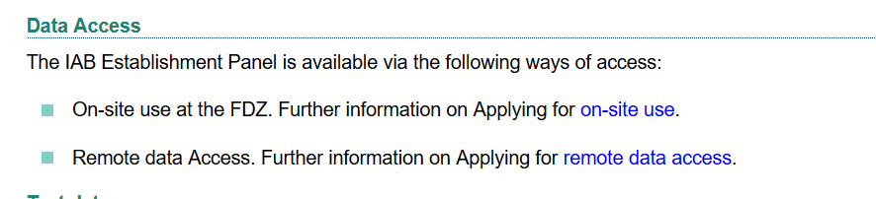
Example 4: German Restricted-access

Slide 63
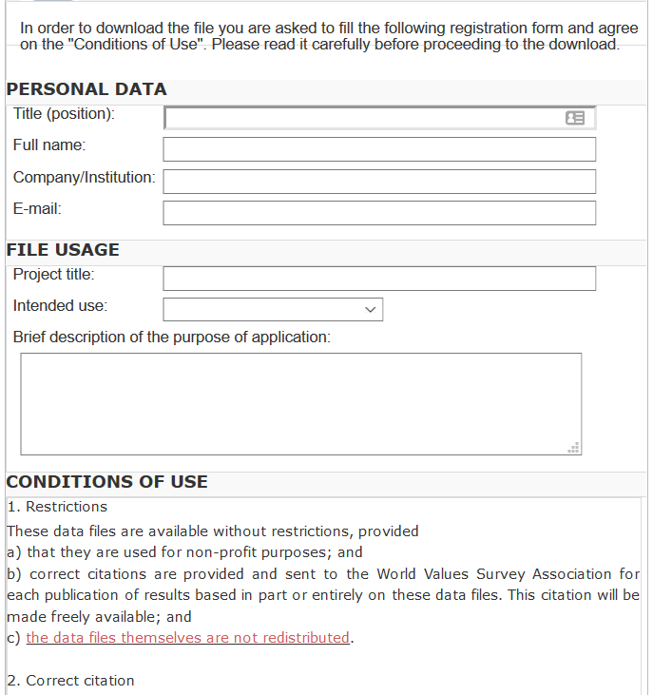
And we check them!
What does the site say?
Please use the following citation when referring to this file in the different versions: Inglehart, R., C. Haerpfer, A. Moreno, C. Welzel, K. Kizilova, J. Diez-Medrano, M. Lagos, P. Norris, E. Ponarin & B. Puranen et al. (eds.). 2014. World Values Survey: Round Six - Country-Pooled Datafile Version: www.worldvaluessurvey.org/WVSDocumentationWV6.jsp. Madrid: JD Systems Institute.
Is that in the README / Paper/ Appendix?
Are all the conditions met/described?

Slide 64
Solution 2: Data Provenance
Keep notes, script as much as possible
(also: Use the Social Science Data Editors’ template README)

Slide 65
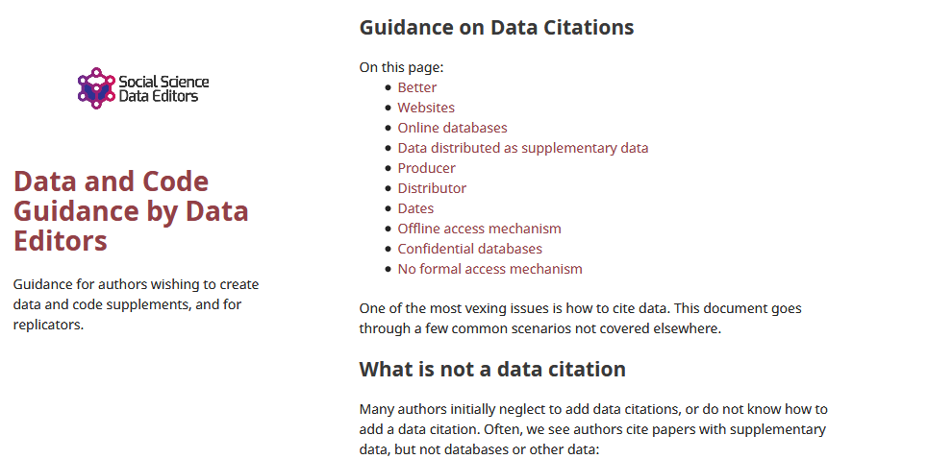
Data citations
Creating specific guidance in the absence of strong discipline-specific guidance
https://social-science-data-editors.github.io/guidance/addtl-data-citation-guidance.html

Slide 66
Example 4: German Restricted-access

Slide 67
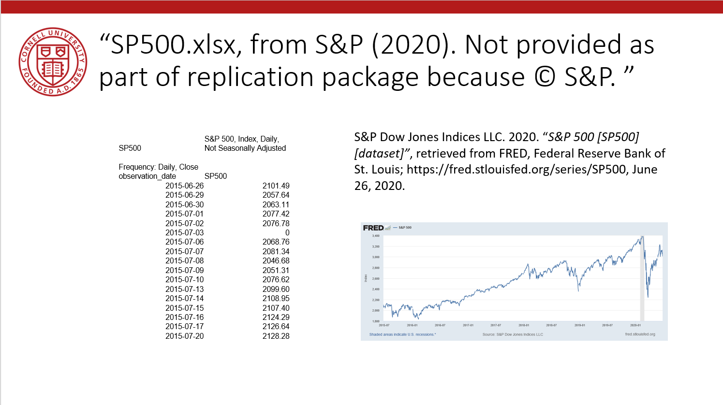
Data Citation
Attributes the file to the proper source

Slide 68
Element of a (data) citation
ICPSR notes that a citation should include the following items:
Author
Title
Distributor
Date
Version
Persistent identifier
Suggested Citation:
S&P Dow Jones Indices LLC, S&P 500 [SP500], retrieved from FRED, Federal Reserve Bank of St. Louis; https://fred.stlouisfed.org/series/SP500, June 26, 2020.

Slide 69
Element of a (data) citation
ICPSR notes that a citation should include the following items:
Author
Title
Distributor
Date
Version
Persistent identifier
Constructed Citation:
Institute for Employment Research (IAB), Establishment History Panel 1975-2018. Accessed via the Research Data Centre (FDZ) of the German Federal Employment Agency DOI: 10.5164/IAB.BHP7518.de.en.v1 June 26, 2020.

Slide 70
Element of a (data) citation
ICPSR notes that a citation should include the following items:
Author
Title
Distributor
Date
Version
Persistent identifier
Constructed Citation:
US Census Bureau, Longitudinal Business Database (LBD) 1975-2018. Last accessed via the Federal Statistical Research Data Centre (FSRDC) June 26, 2020.

Slide 71
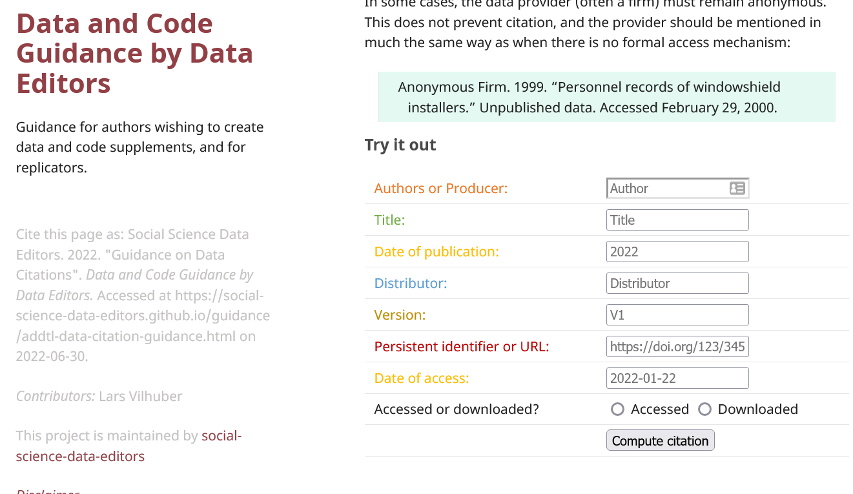
Try it out yourself
Construct an (approximate) data citation
https://social-science-data-editors.github.io/guidance/addtl-data-citation-guidance.html#try-it-out

Slide 72
And we check them!
If the URL does not work, we make a note.
If the site requires registration, we try it out.
How long?
Any requirements?
What does the site say?
Please use the following citation when referring to this file in the different versions: Inglehart, R., C. Haerpfer, A. Moreno, C. Welzel, K. Kizilova, J. Diez-Medrano, M. Lagos, P. Norris, E. Ponarin & B. Puranen et al. (eds.). 2014. World Values Survey: Round Six - Country-Pooled Datafile Version: www.worldvaluessurvey.org/WVSDocumentationWV6.jsp. Madrid: JD Systems Institute.
Is that in the README / Paper/ Appendix?

Slide 73
Data: Citations, Access, Rights
Any data can be cited – even if you can’t download it
Any data that you accessed … can have that access be described
But caution: It should be such that others can also repeat the access!
Just because you “have” the data does not mean you can give it to others
Also: distinguish between “sharing” and “publishing”
Know your terms of use!

Slide 74
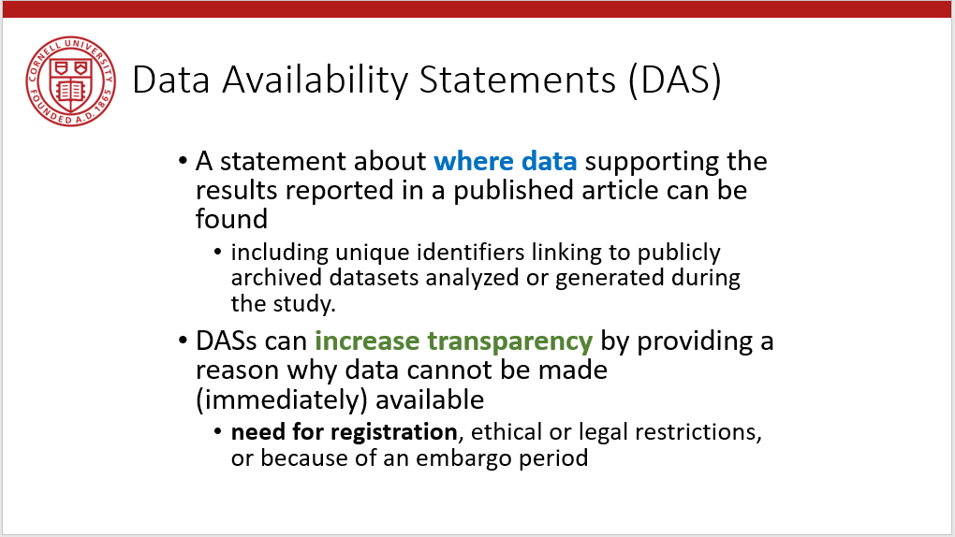
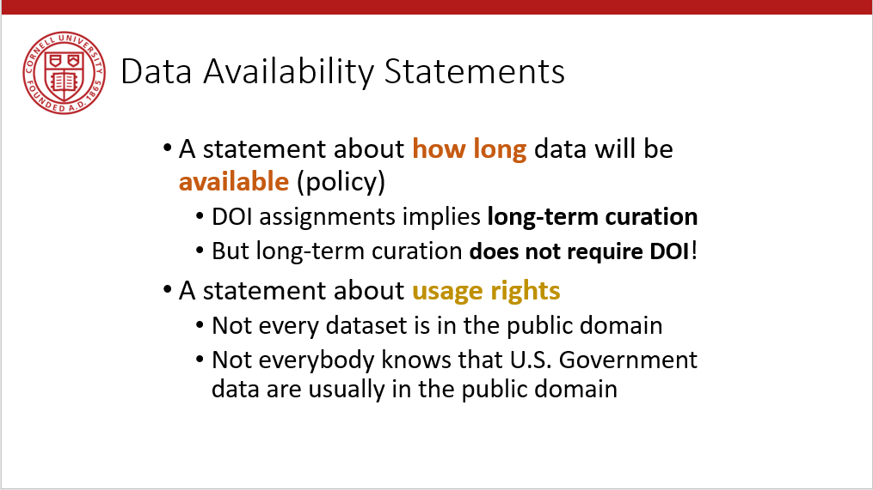
Provide data citations (in manuscript) and data availability statements (in README or appendix)

Slide 75
Solution 3: Data Citations
Cite every data source
(not only the paper that describes the source!)
(also: add them to the Social Science Data Editors’ template README)

Slide 76
Coding for Reproducibility

Slide 77
Lesson 1: Computational empathy
= “Pity the poor replicator”

Slide 78

Streamlining replication packages
Master script preferred
Least amount of manual effort
No manual manipulation
“Change the parameter to 0.2, then run the code again”
No manual copying of results
Write out/save tables and figures using packages
Compute all numbers in package
No manual install of packages
Use a script to create all directories, install all necessary packages/requirements/etc.
Clear instructions!

Slide 79
Extreme examples
Matlab-based simulation
Real example, 10 figures, 4 panels each
For Figure 5a, comment line 52, uncomment line 151, run the code, then copy the figure into your document.
For Figure 5b, comment line 151 again, leave line 52 commented, and change the parameter on line 75 to “3”
….

Slide 80
Extreme examples
Stata-based estimation
4 variants
Run the data creation programs, then copy the data to Folder A
Copy programs “b.do” and “c.do” from Folder A to Folder B, but modify “c.do” on line 20
Once done, convert the output from “d.do” to a Matlab file, and run the simulation in Folder B/C
….

Slide 81
Ideal setup
1 program to prepare the setup
Installs all packages
Creates all directories
1 program (or a very small number) that creates the rest
Possibly with macros/ ado files/ subroutines
Possibly with parameter files that might differ per directory
All tables and figures are output programmatically
Setting up can be done in all languages
Matlab, Stata, R, Python, Fortran
Subroutines exist in all languages
You might need to learn how!
Ability to output figures and tables (Excel, LaTeX) exist in all languages

Slide 82
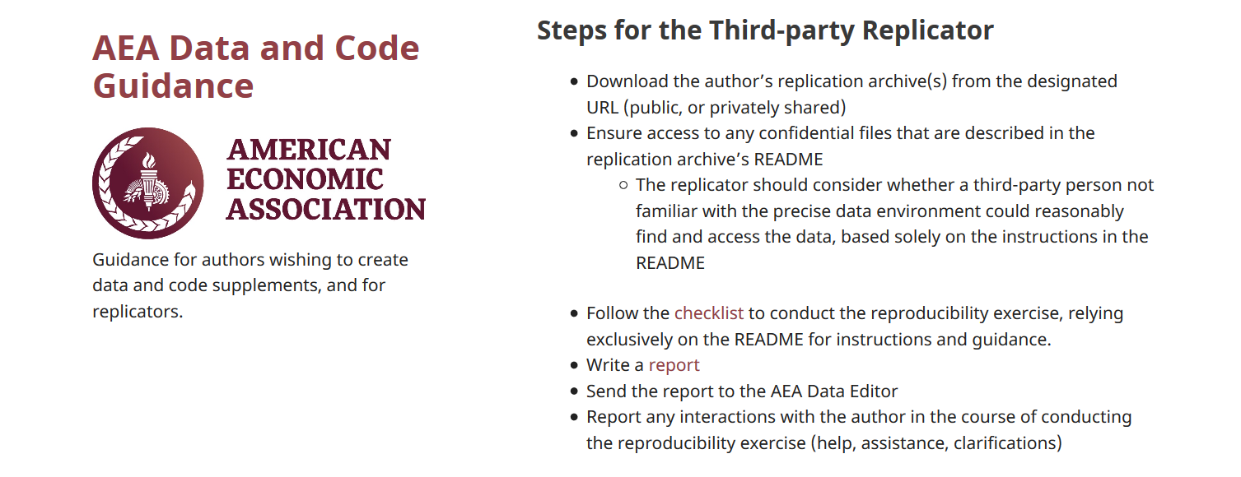
How to prepare the replication package
README
Full package of all programs, data you intend to provide
ZIP it up
Now ask an RA/ colleague/ friend/ grandma/ daughter not previously involved to
Download the package
Follow the instructions in the README without talking to you!
Compare the results to the paper
That’s our Protocol!

Slide 83
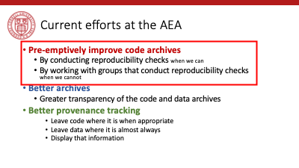
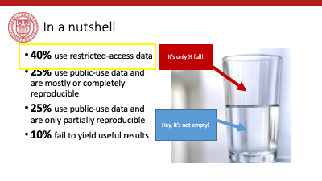
Tension between access and reproducibility

Slide 84


Verification services

Slide 85
Assume replicators can access the data
Sometimes we (=AEA) cannot
We will still check if the code seems complete
We will still verify that all data that *can* be provided have been provided
Plausibility checks
Sometimes we can:
In the past, we have worked with
French, Brazilian, and US confidential admin data
Purchased commercial data (Twitter, Indian GDP)
Proprietary data under NDA/DUA (Ebay)
Data with application procedure (Chinese Panel, Demographic and Health Survey, European establishment data)
Remotely or locally

Slide 86
Solution 4: Computational empathy
Code reproducibly
(and do so right from the start)
(also: way easier to describe in the Social Science Data Editors’ template README)

Slide 87
That’s a lot of stuff to learn and remember… I want to focus on the economics!

Slide 88
Support by Institutions

Slide 89
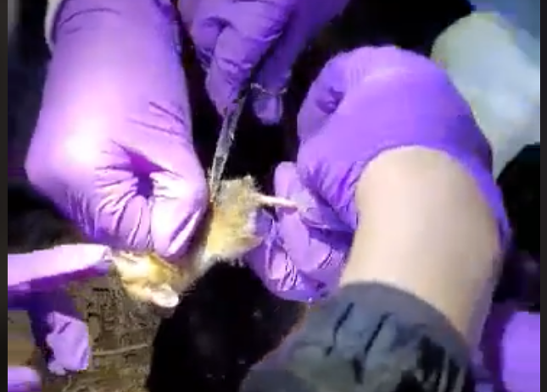
Lesson 3: Support by institutions is insufficient
When should these skills be taught?
These are core “tools of the trade”!
Undergrad, core part of graduate curricula
In other disciplines: students learn how to collect use a pipette, how to tag field mice in the wild…

Slide 90
Lesson 3: Support by institutions is insufficient
Should all of these skills be taught?
How to deposit data
How to set up a compute cluster
Some of these skills fall into other categories, but
Data librarians are understaffed, and not trained in discipline-specific practices
Campus IT has highly varying funding and consulting time
Cross-campus practices are nowhere close to compatible

Slide 91
Lesson 3: Support by institutions is insufficient
Institutional funding and mandates are not adequate
Most grant funding in social sciences does not require (or allow!) for this kind of budgeting
Earmarked portions of funds would be great!
(This is slowly coming, NSF and NIH are making progress)
(Most) Universities consider this an external mandate, not part of their “overhead”
“Provide us with an account, and we will do it”
Leads to highly scattershot infrastructure

Slide 92
Lesson 3: Support by institutions is insufficient
Disciplinary institutions need funding
Direct funding: should archives be treated like infrastructure?
This is the case in many NIH archives
Not quite as ubiquitous in social sciences
Where do you want to preserve 1TB per user per day for the next 50 years? It’s not free…
Indirect funding (via grants)
See previous slide

Slide 93
Lesson 3: Support by institutions is insufficient
All institutions need to consider the user experience
Data provenance and preservation would be a lot easier to implement if scripted
Need for APIs both for upload and download (usage)
Some progress: Zenodo and Dataverse (usually Python, sometimes R)

Slide 94
Lesson 3: Support by institutions is insufficient
Integration of computational resources with data resources is highly inadequate
Most journals have “data” policies, but all research compendia have code – this is a problem with many publishers
Most data repositories are optimized for … data. Support for computational code or actual execution is at best preliminary
See CodeOcean, WholeTale, efforts around Dataverse
See various “continuous integration” using Github, Travis CI, etc. but difficult to integrate data

Slide 95
Solution 5: Institutional support
Complain?
Express your support on the next NSF panel?
?

Slide 96
The role for journals

Slide 97
Goal: Transportability
Any standards, tools, methods: must be transportable across journals (no custom solutions)

Slide 98

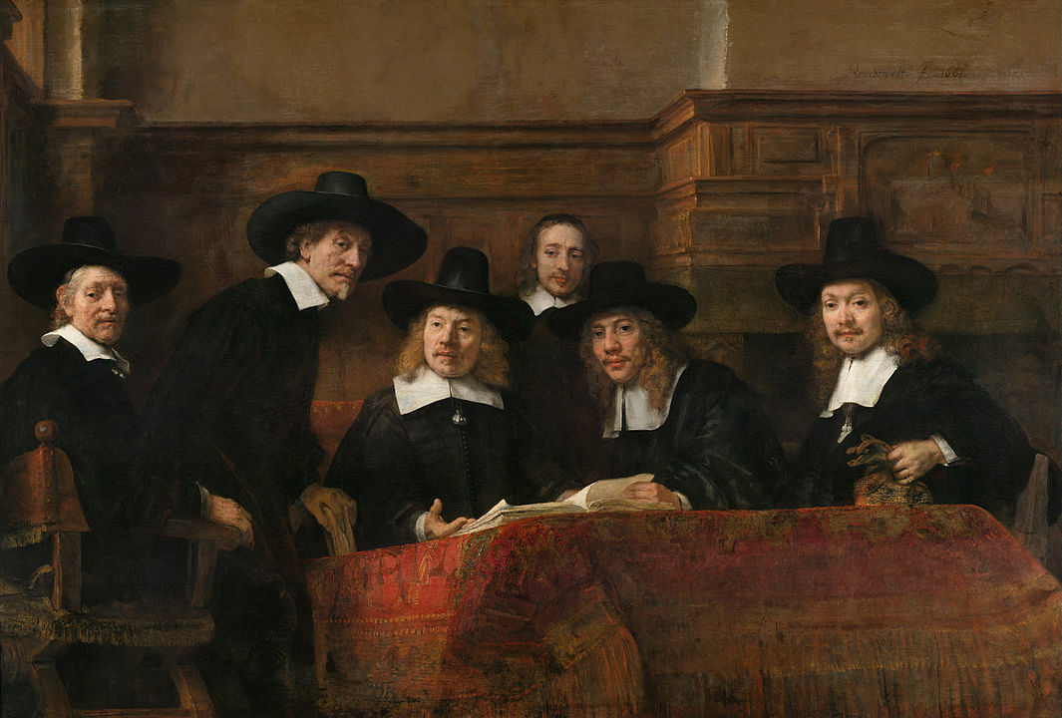
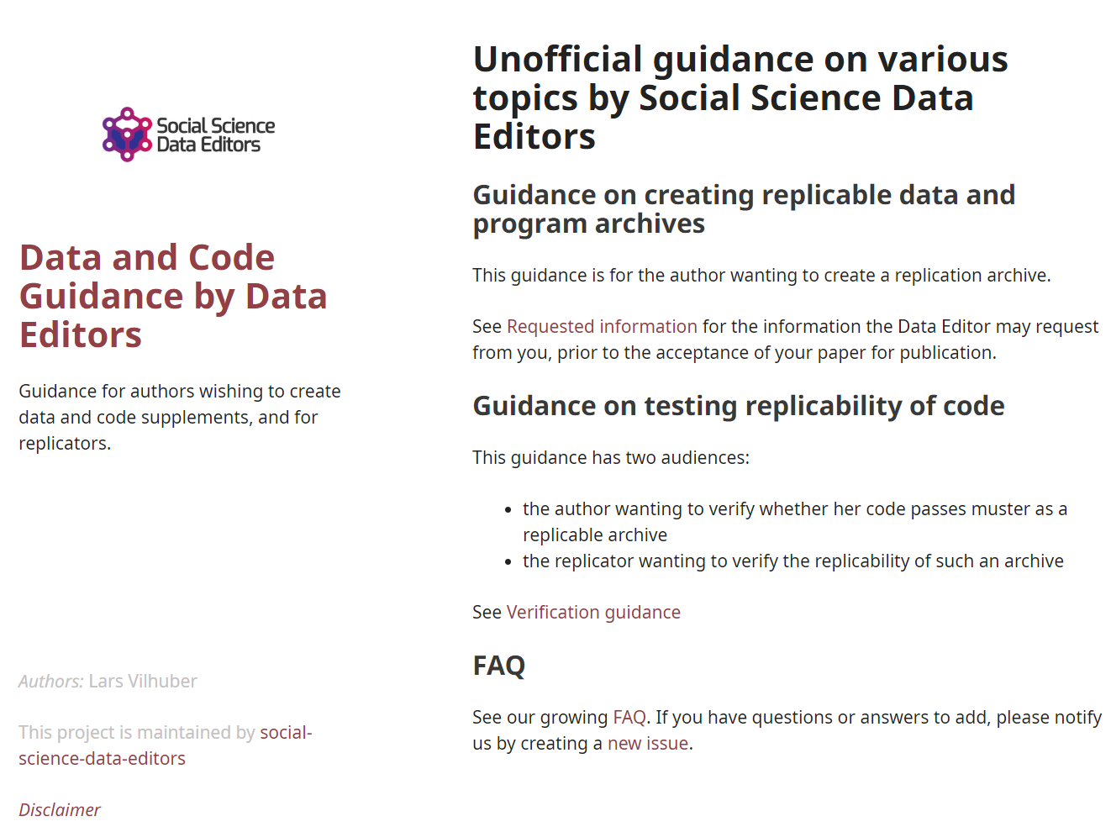
Social science “guild”
https:// social-science -data-editors. github.io/ guidance/

Slide 99
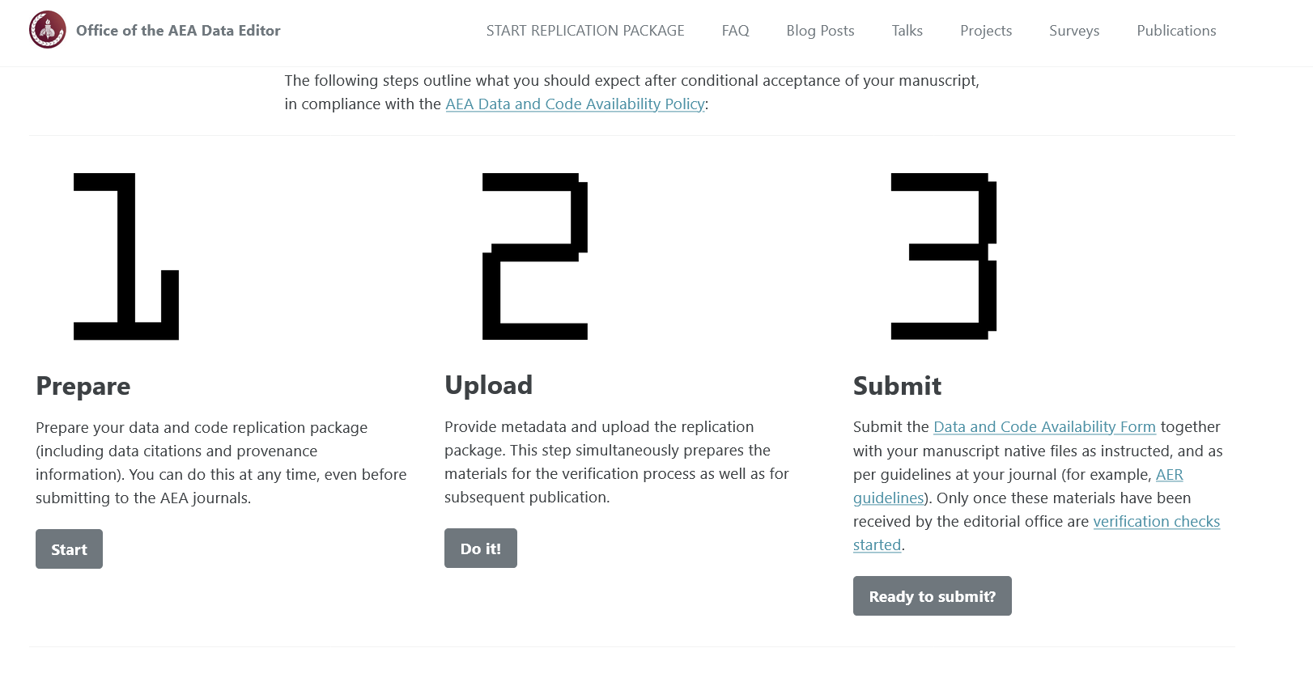

Some resources
https://social-science-data-editors.github.io/guidance/
template README
discussion of licensing
data citation guidance
https://aeadataeditor.github.io/

Slide 100
Thank you!

Slide 101
Example of data provenance

Slide 102
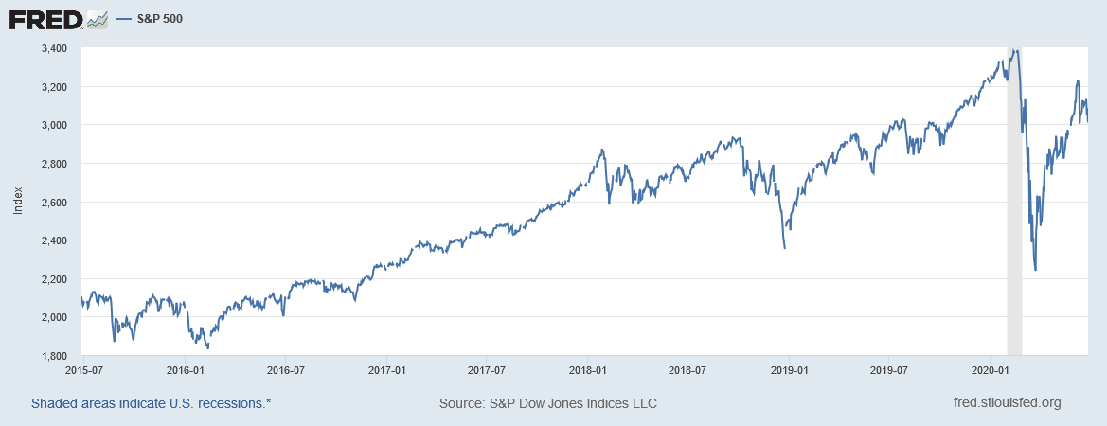
“It’s a file called stockmarket.xlsx”
2101.49
2057.64
2063.11
2077.42
2076.78
0
2068.76
2081.34
2046.68
2051.31
2076.62
2099.60
2108.95
2107.40
2124.29
2126.64
2128.28
2119.21
2114.15
2102.15
2079.65
2067.64
2093.25
2108.57
2108.63
2103.84

Slide 103
“It’s a file called SP500.xlsx”
SP500 | S&P 500, Index, Daily, Not Seasonally Adjusted
Frequency: Daily, Close
observation_date | SP500
2015-06-26 | 2101.49
2015-06-29 | 2057.64
2015-06-30 | 2063.11
2015-07-01 | 2077.42
2015-07-02 | 2076.78
2015-07-03 | 0
2015-07-06 | 2068.76
2015-07-07 | 2081.34
2015-07-08 | 2046.68
2015-07-09 | 2051.31
2015-07-10 | 2076.62
2015-07-13 | 2099.60
2015-07-14 | 2108.95
2015-07-15 | 2107.40
2015-07-16 | 2124.29
2015-07-17 | 2126.64
2015-07-20 | 2128.28

Slide 104
“It’s a file called SP500.xlsx, downloaded from FRED.”
SP500 | S&P 500, Index, Daily, Not Seasonally Adjusted
Frequency: Daily, Close
observation_date | SP500
2015-06-26 | 2101.49
2015-06-29 | 2057.64
2015-06-30 | 2063.11
2015-07-01 | 2077.42
2015-07-02 | 2076.78
2015-07-03 | 0
2015-07-06 | 2068.76
2015-07-07 | 2081.34
2015-07-08 | 2046.68
2015-07-09 | 2051.31
2015-07-10 | 2076.62
2015-07-13 | 2099.60
2015-07-14 | 2108.95
2015-07-15 | 2107.40
2015-07-16 | 2124.29
2015-07-17 | 2126.64
2015-07-20 | 2128.28

Slide 105
“It’s a file called SP500.xlsx, downloaded from FRED.”
S&P Dow Jones Indices LLC. 2020. “S&P 500 [SP500] [dataset]”, retrieved from FRED, Federal Reserve Bank of St. Louis; https://fred.stlouisfed.org/series/SP500, June 26, 2020.
SP500 | S&P 500, Index, Daily, Not Seasonally Adjusted
Frequency: Daily, Close
observation_date | SP500
2015-06-26 | 2101.49
2015-06-29 | 2057.64
2015-06-30 | 2063.11
2015-07-01 | 2077.42
2015-07-02 | 2076.78
2015-07-03 | 0
2015-07-06 | 2068.76
2015-07-07 | 2081.34
2015-07-08 | 2046.68
2015-07-09 | 2051.31
2015-07-10 | 2076.62
2015-07-13 | 2099.60
2015-07-14 | 2108.95
2015-07-15 | 2107.40
2015-07-16 | 2124.29
2015-07-17 | 2126.64
2015-07-20 | 2128.28

Slide 106
“SP500.xlsx, from S&P (2020). Not provided as part of replication package because © S&P. ”
S&P Dow Jones Indices LLC. 2020. “S&P 500 [SP500] [dataset]”, retrieved from FRED, Federal Reserve Bank of St. Louis; https://fred.stlouisfed.org/series/SP500, June 26, 2020.
SP500 | S&P 500, Index, Daily, Not Seasonally Adjusted
Frequency: Daily, Close
observation_date | SP500
2015-06-26 | 2101.49
2015-06-29 | 2057.64
2015-06-30 | 2063.11
2015-07-01 | 2077.42
2015-07-02 | 2076.78
2015-07-03 | 0
2015-07-06 | 2068.76
2015-07-07 | 2081.34
2015-07-08 | 2046.68
2015-07-09 | 2051.31
2015-07-10 | 2076.62
2015-07-13 | 2099.60
2015-07-14 | 2108.95
2015-07-15 | 2107.40
2015-07-16 | 2124.29
2015-07-17 | 2126.64
2015-07-20 | 2128.28

Slide 107
Data Availability Statements
Describes data file, where to get it, how to get it, and any conditions of obtaining it

